Slide 1
Getting started with Github
A guide for CONNECT study investigators and other non-developers.

Slide 2

Documents change over time
Document 1
The reign in Spain stays mainly on the plains.
Document 2
The unexamined life is not worth living
Version | Documents
2b73114 | Document 1 Document 2
Version | Documents
781efc8 | Document 1 Document 2
2b73114 | Document 1 Document 2
Document 1
The rain in Spain stays mainly on the plains.
Document 2
The unexamined life is not worth living

Slide 3
Git tracks changes
Version | Documents | Log
6522120 | Document 1 Document 2 Document 3 | Added document 3
781efc8 | Document 1 Document 2 | Correct spelling
2b73114 | Document 1 Document 2 | Initial check-in

Slide 4
Git is distributed
My Repository
Your Repository
clone
Add document 4
Edit document 3
pull
get document4
pull request
Asks me to pull your changes
pull
get edits

Slide 5
Github allows online git repositories
fork
My github repository
UserN’s github repository
clone
clone
clone
***
My laptop repository
User1 copy
UserN copy

Slide 6
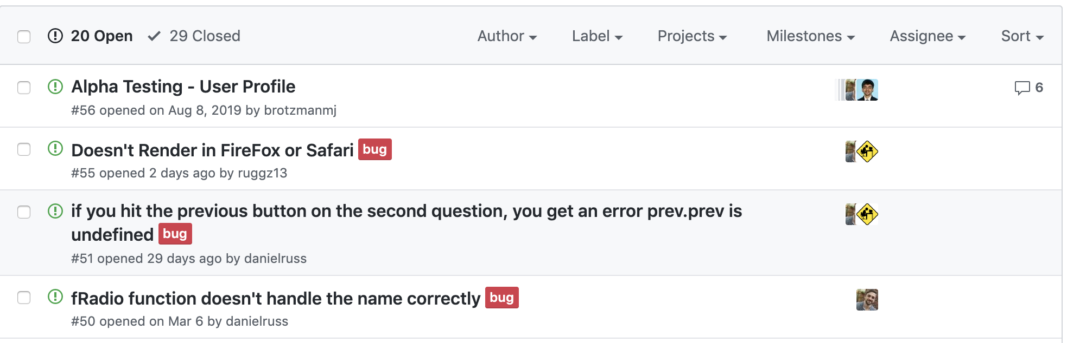
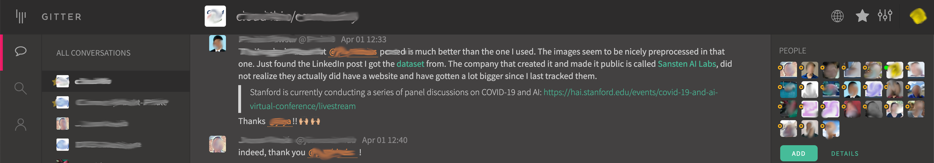
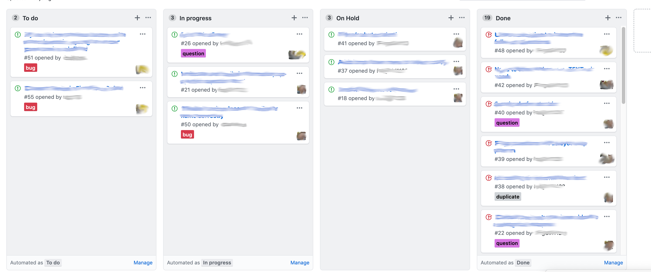
Github has other useful features
Issues
Gitter
Kanban Boards

Slide 7
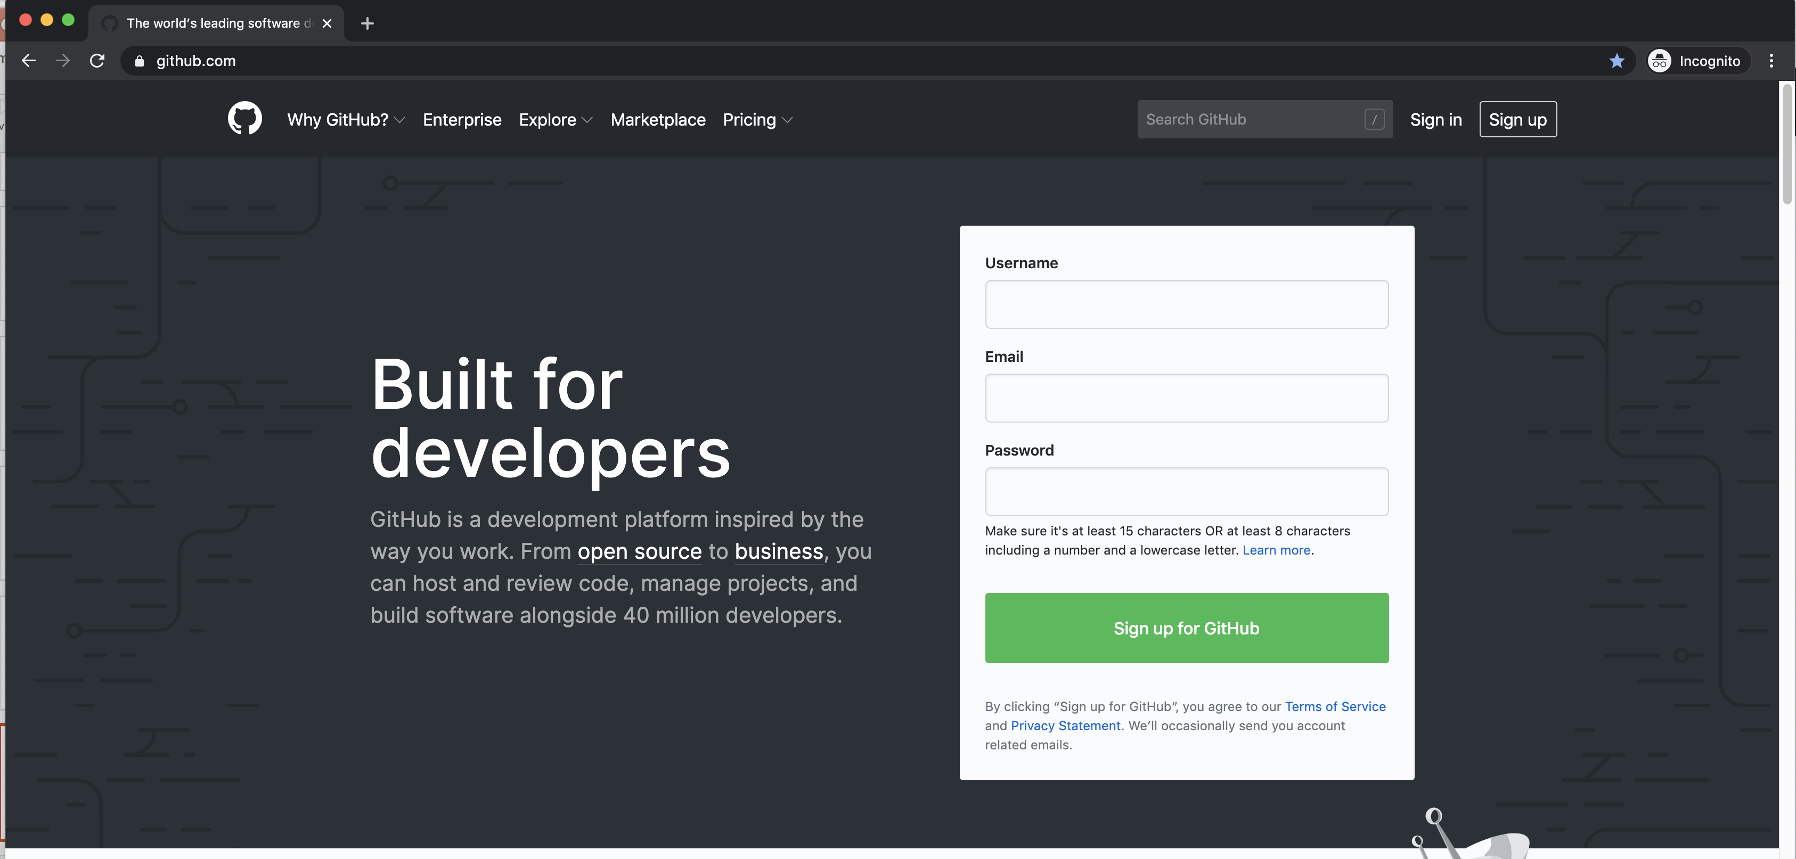
Getting on Github

Slide 8
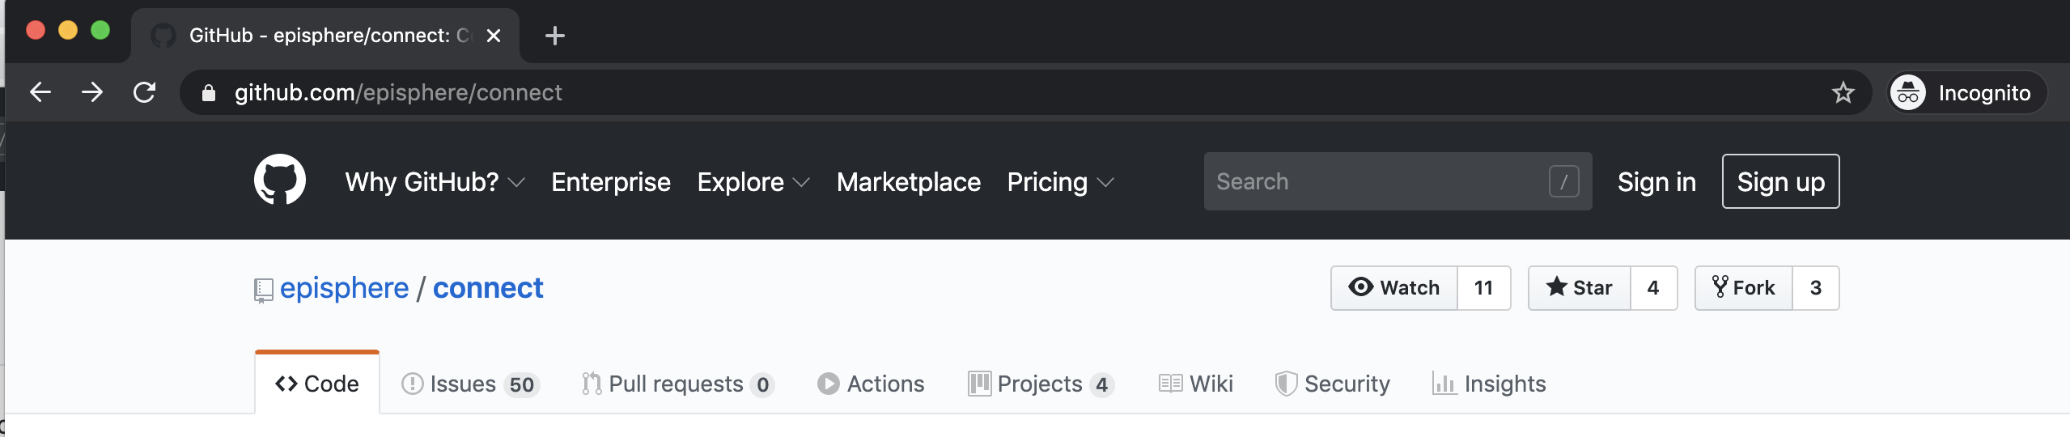
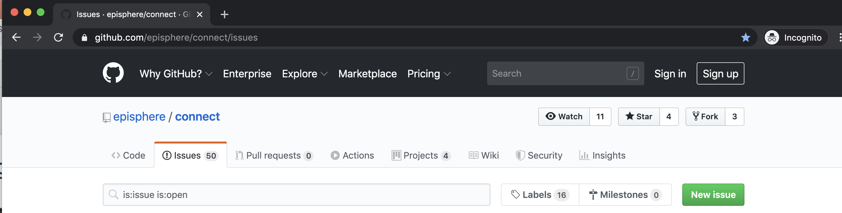
Creating an Issue (Bug report)
https://github.com/episphere/connect

Slide 9
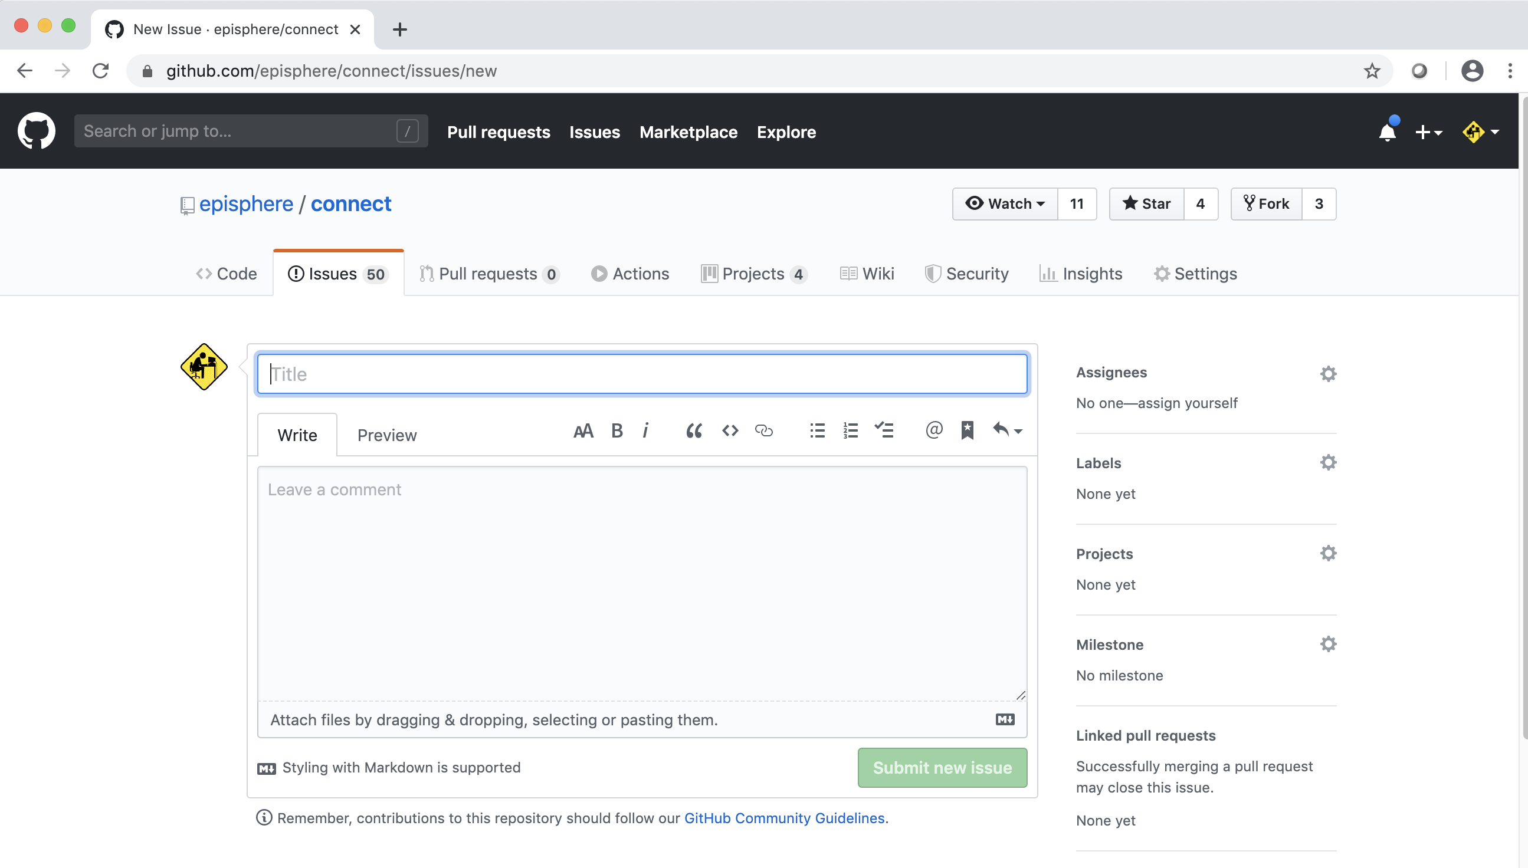
Creating an Issue
Short description of the issue
Detailed description of the issue

Slide 10
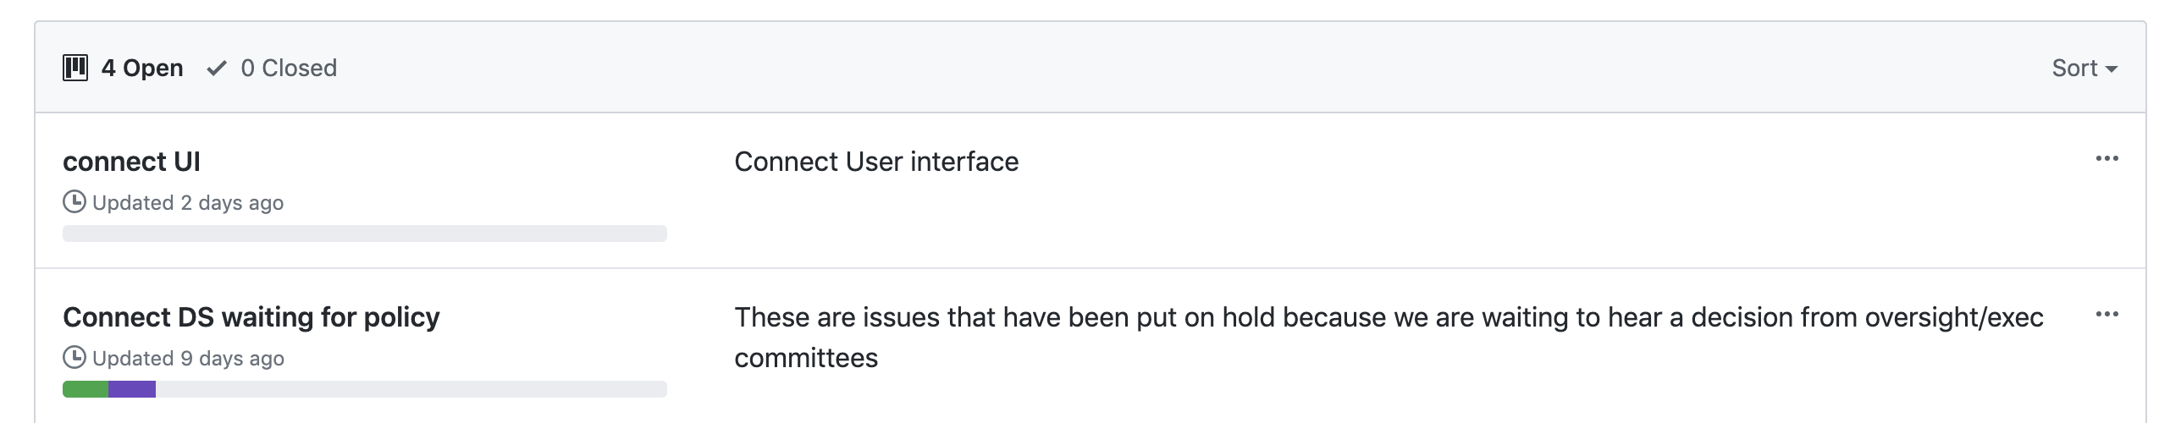
Tracking issues with the Github Kanban

Slide 11
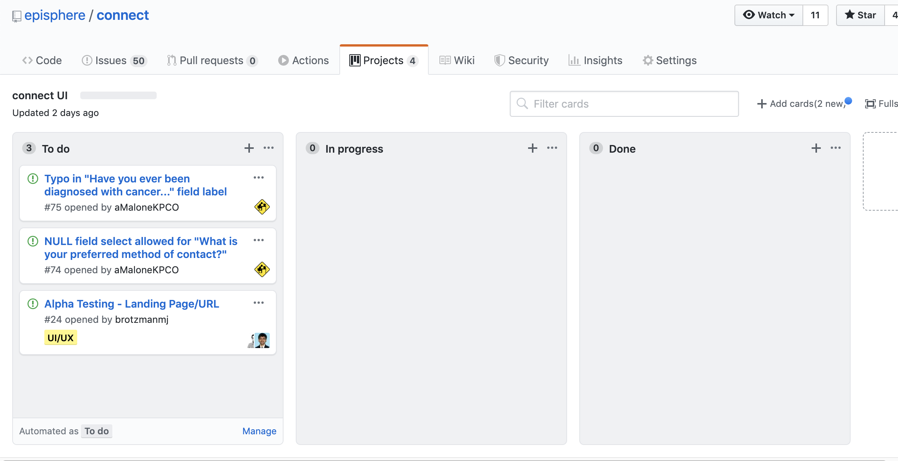
Cards can be dragged into other columns, or set up to do it automatically

Slide 12
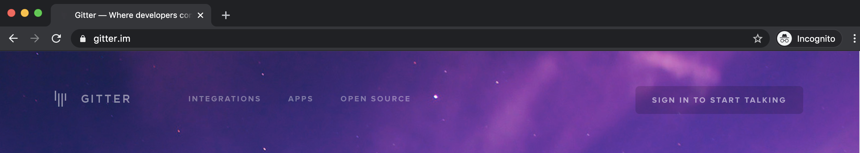
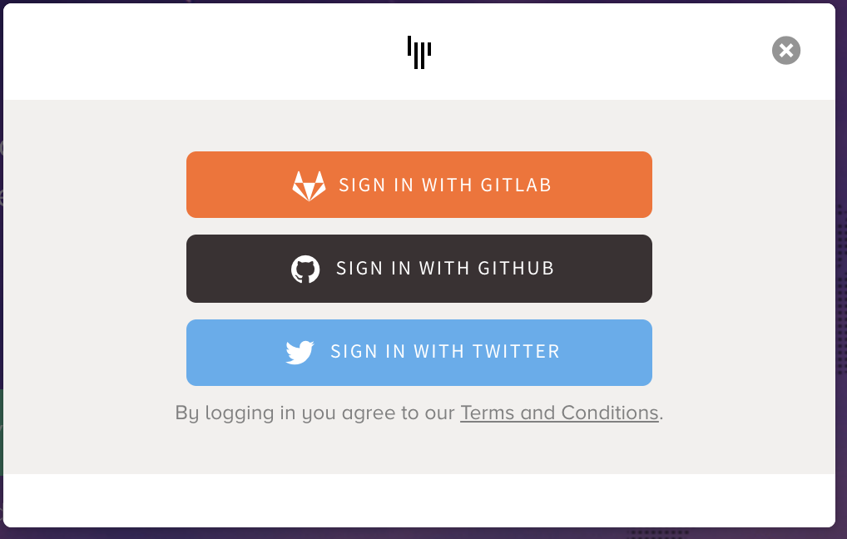
Communicating via Gitter https://gitter.im

Slide 13
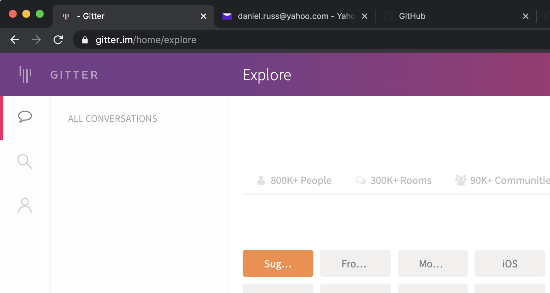
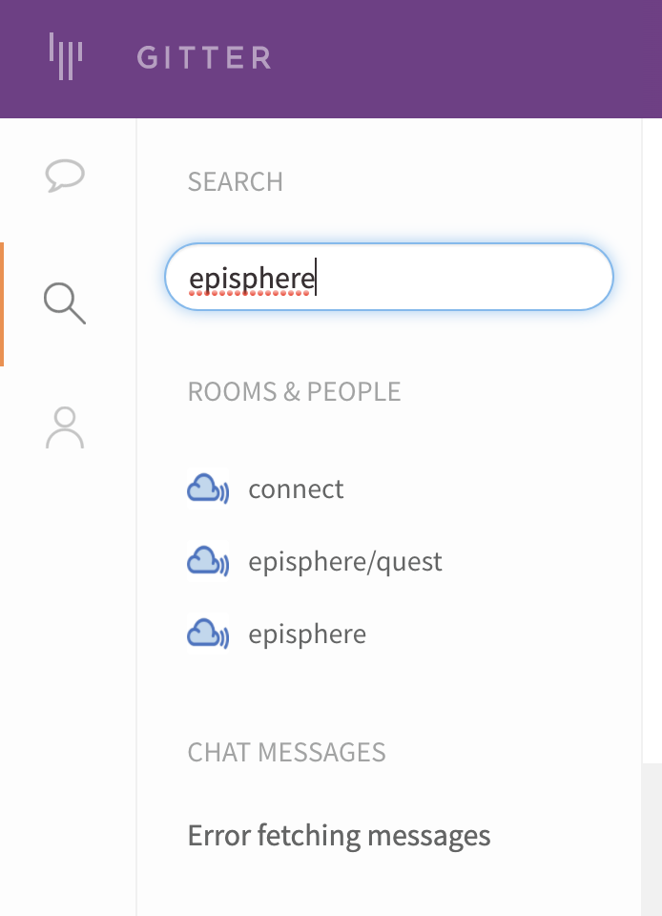
Joining a gitter chat

Slide 14
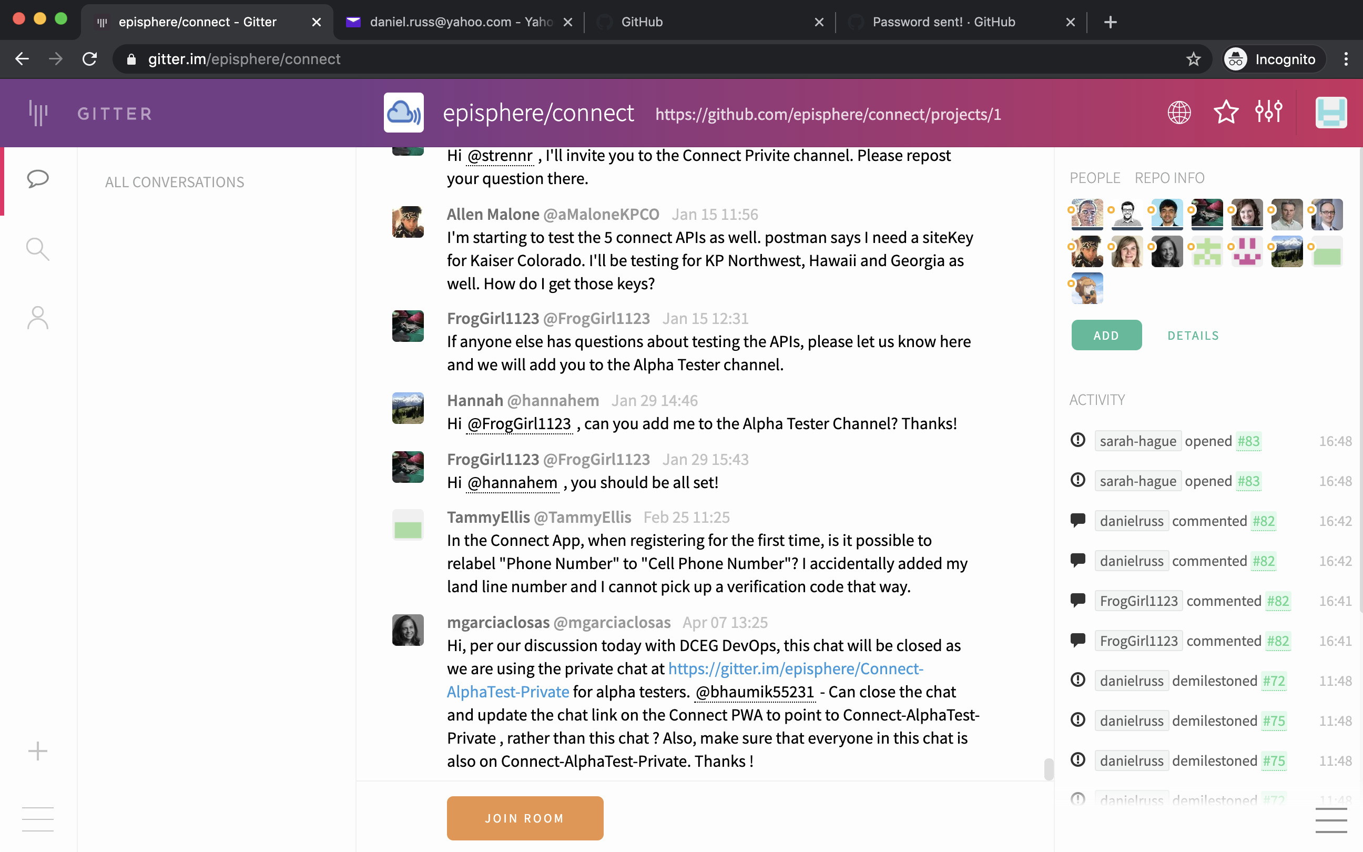

Slide 15
Last comments and Questions???
This powerpoint is available in github. https://github.com/

